Slide 1
Winter Storm Ulmer, a “Bomb Cyclone” and Blizzard in Nebraska
A look at how quickly things can change in 72 Hours
AOSC 100- Spring 2019

Slide 2
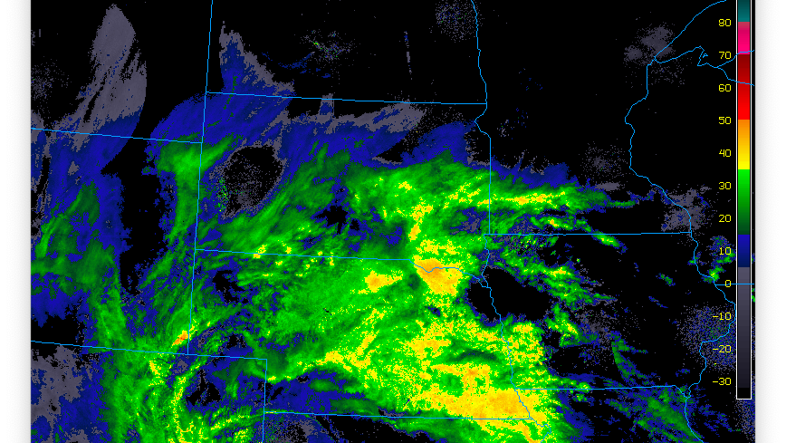
Introduction
Winter Storm Ulmer, a “ Bomb Cyclone”, and Blizzard effects in Nebraska.
A look at how weather unfolded in Nebraska March 12-March 14,2019
Bad Times in Nebraska were on the way…
Notes:
Winter storm Ulmer as it was named, stemmed out of clash of weather fronts that occurred on the eastern side of the Rocky mountains. Storms that generate in this area are often referred to as ”Colorado Lows” . This is typified by upper level air crossing the Leeward (Eastern ) side of the Rocky mountains producing a trough in the wind and enhances Low frontal development on the Ground (Lutgens, p239). In Low pressure fronts, winds rotate inward (Counterclockwise) and upward, drawing in warm moist air from a water source. In this case, the water source was a Maritime Tropical air mass in the Gulf of Mexico. As the Moist (less dense) air rises it cools and condenses and forms rain or snow. The High pressure front rotates in an opposite (Clockwise) direction and rotates outward and down The air mass that was providing the cold air was a Continental Polar air mass. The collision of these two frontal boundaries set the stage for the intensification of the storm. How it got to the intensity that it did and what made it classified as a ‘Bomb Cyclone” I will attempt to explain as this paper progresses. Due to the enormity of the storm it would be unreasonable for a new student of Meteorology to try to explain all facets of the storm. This event caused massive flooding, wind damage, and blizzard conditions in a wide swath of our nation. I have elected to focus my inquiry on the blizzard conditions in the state of Nebraska. It is important to remember is that weather has to be observed on the SURFACE as well as ALOFT.

Slide 3
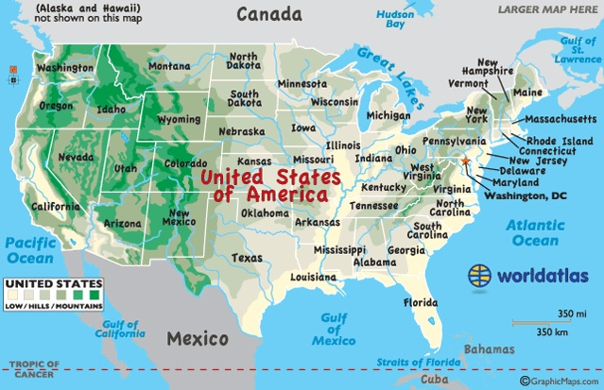
Background of our Topography and Features
Notes:
As can be seen from this this Map (Obtained from www.worldatlas.com) the United States is made up of a number of prominent topographical features . Nebraska lies to the East of the Rocky Mountain Range and is not uniform in its elevation. To the West, as can be seen by the chart graphic, begins lower level mountains ( Approximately 6000 Feet in elevation). As the state continues to the East it slopes downward what the chart describes as hills, and in the southern part of the state the lands are described as low. These varying elevations in topography play in to weather and how it can unfold. At this latitude in the United States, winds flow front the west toward the east. This flow of wind ,at the surface, is altered by topography affects weather conditions.
Another important factor to consider is available sources of water. To the West side of the US lies the Pacific Ocean, to the SW lies the Gulf of California, and finally to the south lies the Gulf of Mexico. The Atlantic Ocean is not forgotten but does not play as much of a factor due to where Nebraska is situated. With these abundant sources of water to feed growing storms weather can get the fuel it needs to grow and intensify. Another Prominent feature is the Canadian North. As it is generally colder, the farther north you get, Continental Polar (cP) Air Masses flow down and interact with Maritime Tropical (mT) air masses flowing up from the south. Active weather is the result.

Slide 4
Analysis: List of Data Products
National Forecast Chart Images (NOAA Weather Prediction Center)
Charts Created by Meteogram Data (Wyoming Weather Web)
GOES IR and WV Images (Illinois WW2010)
Surface Fronts (Wyoming Weather Web)
Surface Streamlines (Plymouth State Weather Center)
Upper Air Analysis: 850,700,500,300 mb ( Storm Prediction Center)

Slide 5
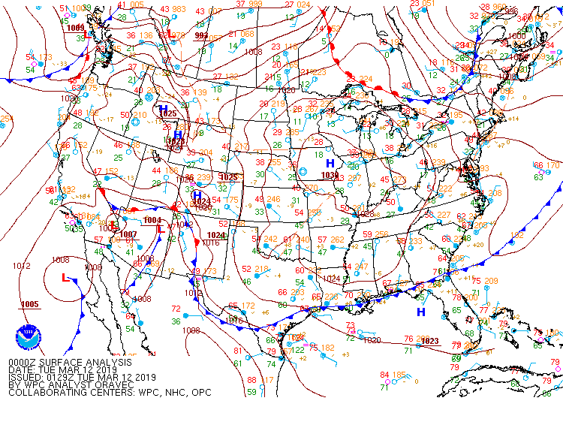
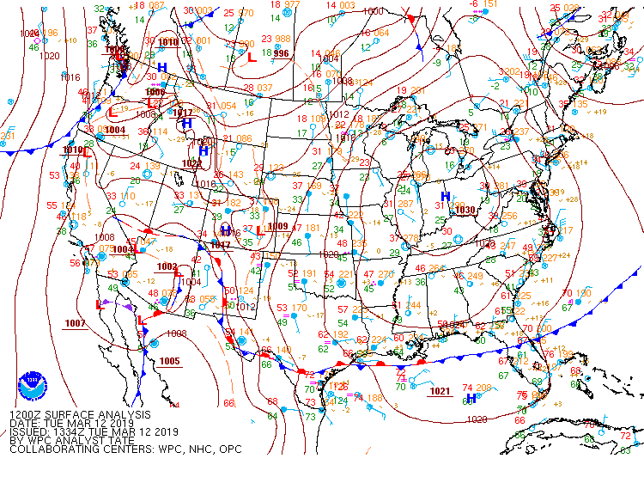
Surface Analysis Map 3/12 00Z
Surface Analysis Map 3/12 12Z
Notes:
These Surface Analysis Maps are for 3/12/19 at 00Z and 12Z . A low pressure cell (represented by a RED “L”) can be seen that formed on the east side of the Rocky Mountains between 00Z and 12Z. According to our textbook “East of the Rocky’s, warm fronts are usually associated with maritime tropical (mT) air that enters the United States from the Gulf of Mexico and “glides” over cooler air positioned over land” (Lutgens, p227). The specific location of this Low cell is the South East Corner of Colorado adjacent to Kansas. Additionally there are 4 other Low cells (to the West) in the Southwest part of the country and upper Mexico . A stationary frontal boundary (represented by a line that has Blue Triangles and Red Semi-Circle marks on opposite sides) that stretches from NE Arizona down through New Mexico and into Texas separates 4 High pressure cells (represented by a BLUE “H”) to the East, that stretch roughly NW to SE along the Rocky mountain Range.
A word about Low and High pressure systems is in order to set the stage and describe what is happening. Low pressure systems rotate counterclockwise inward and upward. High Pressure systems, conversely rotate outward and downward. This is important because Low Pressure systems draw in warm, many times moist, air and rise it aloft. Rising Air= Active Weather (Krayer, 2019). High Pressure systems are associated with cold sinking air that is not moisture laden.

Slide 6
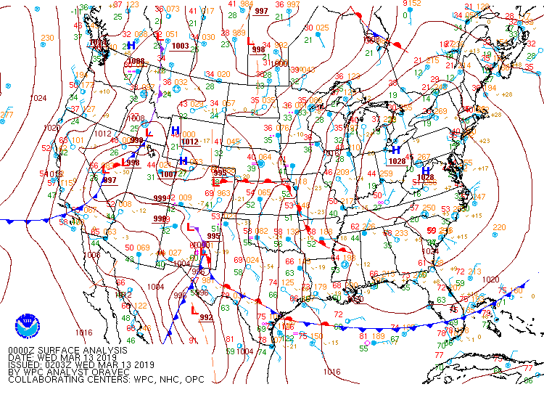
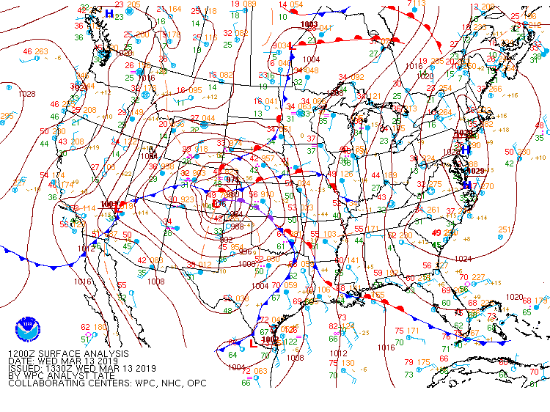
Surface Analysis Map3/13 00Z
Surface Analysis Map 3/13 12Z
Notes:
These Surface analysis maps so several things that need to be explained. The lines that show a Low Front are RED semi Circles on the side the front is moving to. Conversely, a High Pressure front is represented by a blue line with blue triangles pointing in the direction the front is moving to. Additionally light blue colored wind barbs show the direction the wind is coming from. A full explanation of how to read a surface chart can be seen at the following Hyperlink(https://www.weather.gov/jetstream/wxmaps).
What becomes evident on the 00Z map is that several fronts have become clearly formed and are starting to strengthen and intensify. The brown lines on the maps connect areas of equal air pressure, The closer the lines (isobars) are being closer together indicate a steeper pressure gradient and more intense weather. Another type of frontal line is represented on the 12Z map and that is an Occluded front. It is a purple line with alternating Purple Triangles and Purple Semi Circles. An occluded frontal boundary represents a rapidly moving cold front overtaking a warm front ( Lutgens, p.230). This makes sense when you compare the 00Z image and 12Z image. Cold fronts (H) are very steep ad move at a rate 50% faster than warm(L) fronts (Lutgens, p.230). The wind barbs show the counter clockwise rotation showing the influence of the low front. Keep in mind that moist air is converging from the south where it is being drawn aloft.

Slide 7
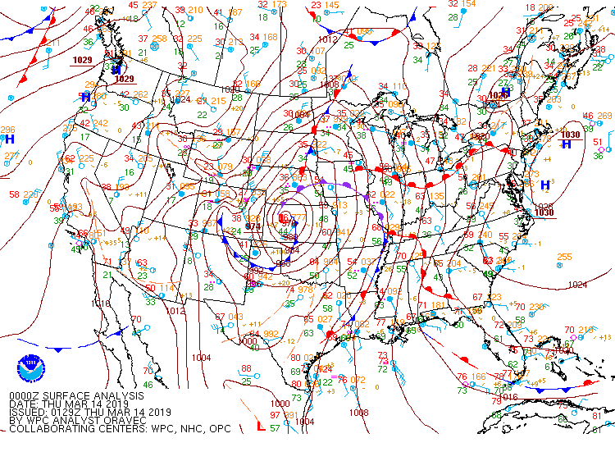
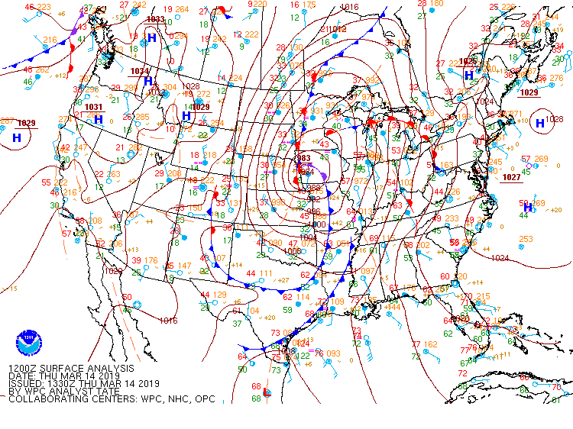
Surface Analysis Map 03/14 00Z
Surface Analysis Map 3/14 12Z
Notes:
The Map of 3/14 00Z shows the intensity of the storm, as represented by the very closely spaced isobars, cyclonic rotation and multiple frontal boundaries formed around the low (L) front that is just south of Nebraska in the state of Kansas. What this image depicts is that there is cold air coming down from the North behind the cold front. The cold front is pushing warm moist air that is coming from warm tropical air producing exaggerated lift. The occluded front usually occur in the later stages of a storms life cycle (Lutgens 230). This is a cold occluded front which promotes lifting of both the warm air and the cool air that rides ahead of the impending cold front. According to Ludgens “ in winter the affected region may experience Blizzard conditions” (Lutgens, p230). The position of this storm and the associated occluded front are telling. In Low pressure systems, also known as Mid Latitude cyclones, heavy snowfall usually occurs north of the center of the storm (Lutgens p240). Of note are the very tight spacing of the isobars indicating a very steep wind gradient to the North and West of the storm center. This is Nebraska, Kansas, and Colorado.

Slide 8
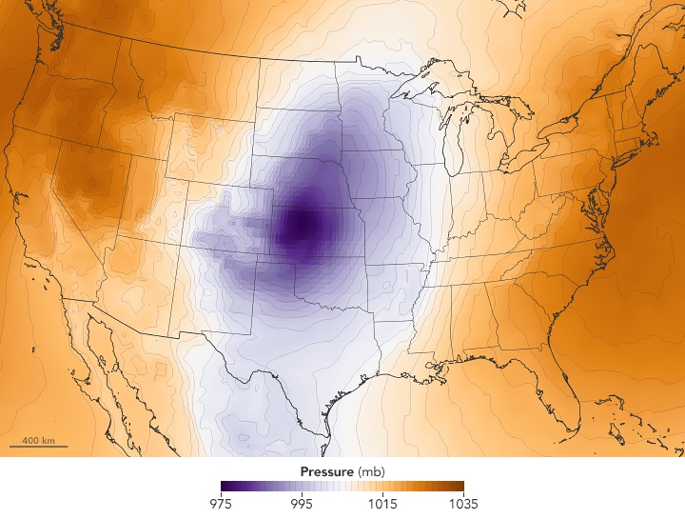
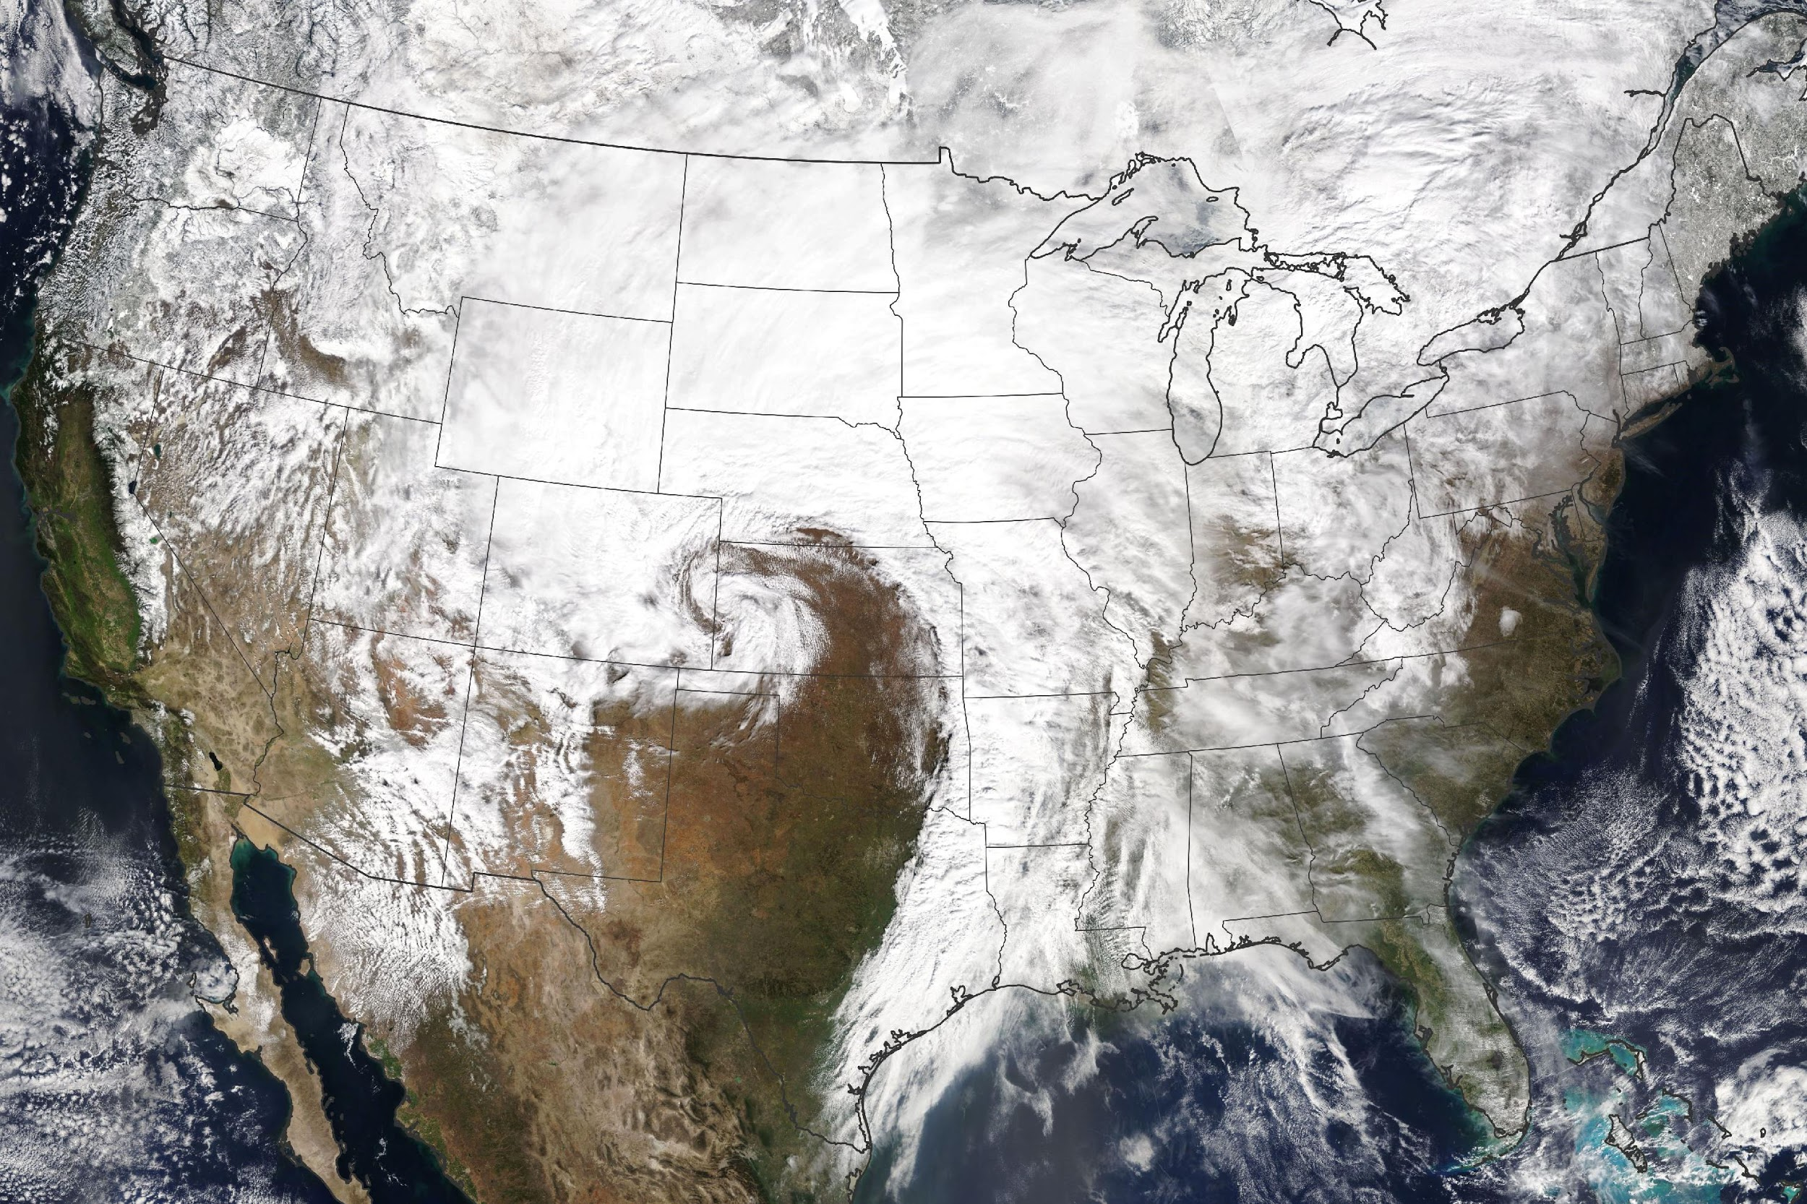
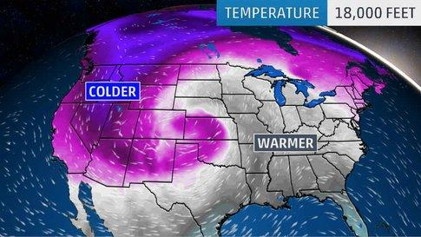
Barometric Pressure
2
Water Vapor
1
33
Notes:
As I am not a meteorologist but a new student to the science, I will attempt to explain the events in simple terms and concepts adding more depth as I discuss different observations made by way of a series of maps and charts that depict the weather conditions during different time periods of the storm.
There are three main things that needed to be evaluated that contribute to the creation and intensity of Winter Storm Ulmer. They are depicted in images 1-3 above.
Image 1 shows the Barometric Pressure range across the US on March 13, 2019 ( Story by Katherine Hanson, NASA Earthobservatory webpage, accessed 4/1/19)
Image 2 shows the water vapor image across the US on March 13, 2019 ( Story by Katherine Hanson, NASA Earthobservatory webpage, accessed 4/1/19)
Image 3 shows an depiction of the cyclonic nature of he Low Pressure system the US at 18000 feet above sea level on March 13 2019 (Article by Chris Dolce, Weather.com, accessed 4/1/19)
These three elements: Barometric Pressure, Water Vapor, Pressure system, along with wind flows, show how this storm gained and sustained the power that it did and resulted in devastating combination of outcomes that the Midwest is not soon to forget.

Slide 9
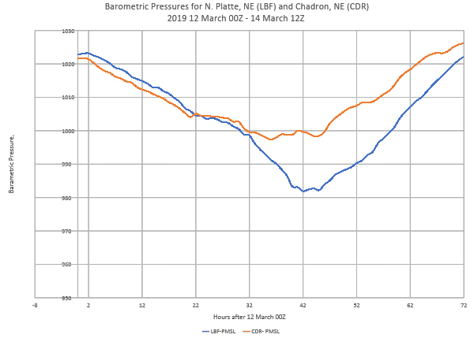
Notes:
Barometric pressure readings for N. Platte NE (LBF) and Chadron NE (CDR) from 3-12-19 00Z through 031419 12Z. On the preceding page the top left graphic showed a visual of the center of the ” Bomb Cyclone” or Bombogenesis. To meet the criteria for Bombogenesis the Barometric pressure needs to drop 24 points in 24 hours (Chris Dolce, Weather.com). This chart shows that was in fact the case in N. Platte NE (LBF) but was NOT the case in Chadron NE (CDR). In N. Platte the lowest barometric pressure reading was 982mb, 24 hrs prior the pressure had been 1010mb. This represents a drop of 28 mb in a 24 hour period! The drop in pressure was significant in Chadron NE as well but did not rise to the Bombogenesis mark. The buzzwords make for great news bites but what do they mean? In essence the more the barometric pressure drops and the quicker it drops the more stormy the weather is going to be. Referring back to the image on the prior page the differences in between pressures seen at N. Platte and Chadron make sense. N. Platte is closer to the center of the storm and Chadron is farther to the west of the storm. Additionally, there are altitude differences to consider. Barometric pressure drops with altitude. Chadron is 3,379’ in height, as opposed to N. Platte which is at 2,800”. The extreme drop in Due dew point was directly related to the Low Front.

Slide 10
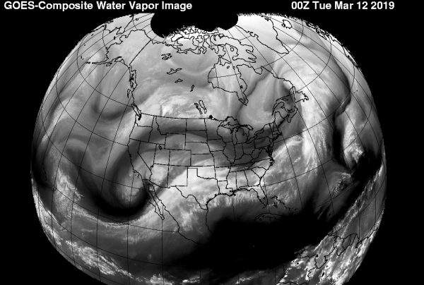
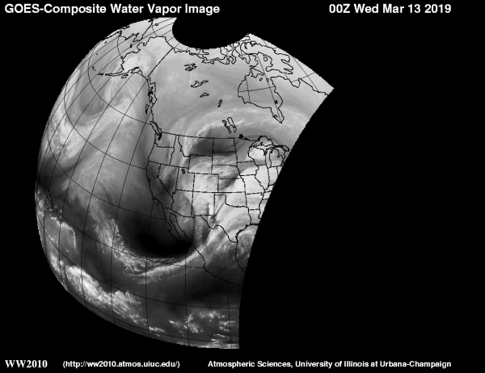
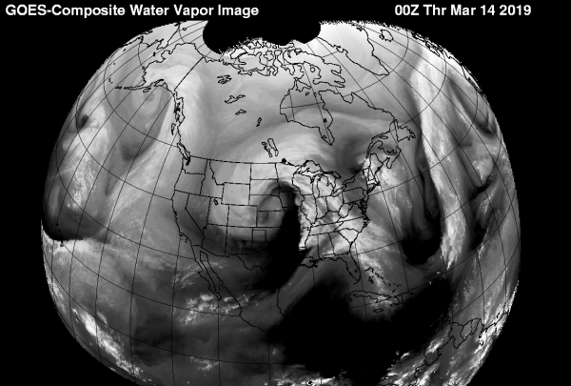
Notes:
GOES Water Vapor Images 3/12 – 3/14, Show the presence of an atmospheric river of moisture being drawn from a Maritime Tropical (mt) water source. The white river of moisture can clearly be seen flowing from the southwest to the northeast. If you look at the image from 3/14 00Z it looks identical to Image #2 &3 two pages back that represent the influx of moisture to the storm system as well as the cyclonic lifting power associated with the Low Pressure system.

Slide 11
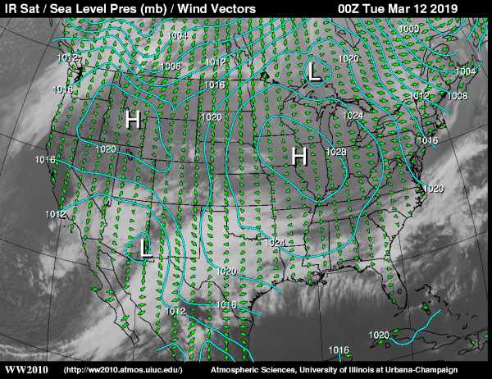
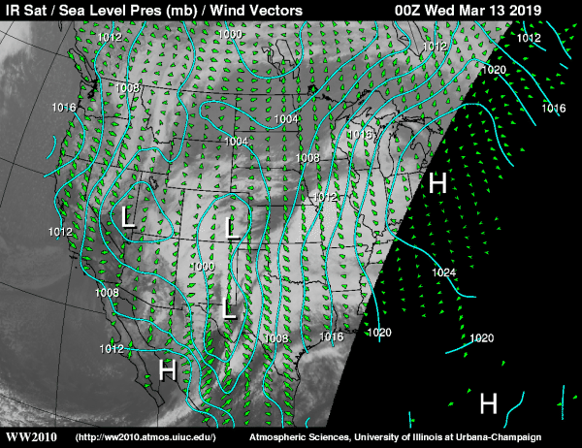
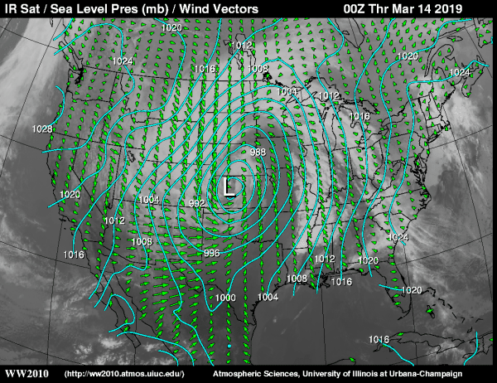
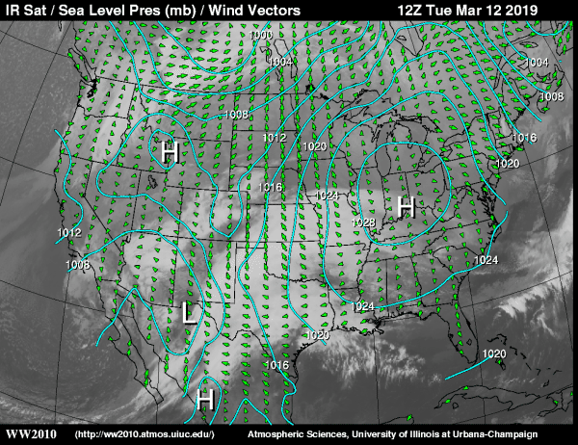
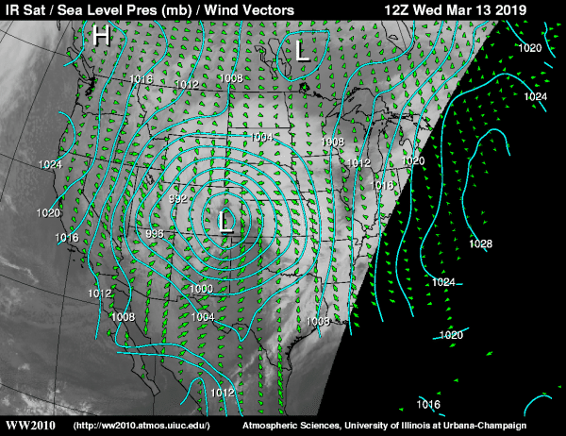
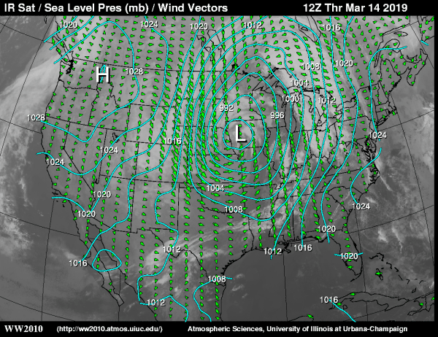
Notes:
IR Satellite, Surface Pressure, Fronts and Wind Vectors for 3/12-3/14. I elected to use this series of slides because it helps drive home storm movement, wind direction and the intensity of the low front. First lets speak to intensity. The images of 3/13 12Z and 3/14 00Z tell a clear tail tale. The closeness of the isobars show the steep wind gradient that existed. The wind vectors show the clear cyclonic action of the low front. Though this is an IR image the white reflective surface of the cloud tops can clearly be seen and form the classic comma shape of Low fronts. On the image of 3/14 at 12Z it can be seen that the low front has moved eastward and is beginning to spread. Also noted in this image is the massive influx of Cold air from the north. As the air is drawn down and curves around the base of the Low Front, a Dryline develops. A Dryline forms behind a cold frontal boundary. If you go back to the surface map on page 7 you will see the cold front in place and the dryline behind it.

Slide 12
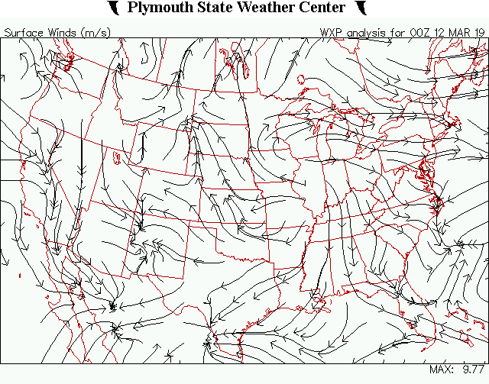
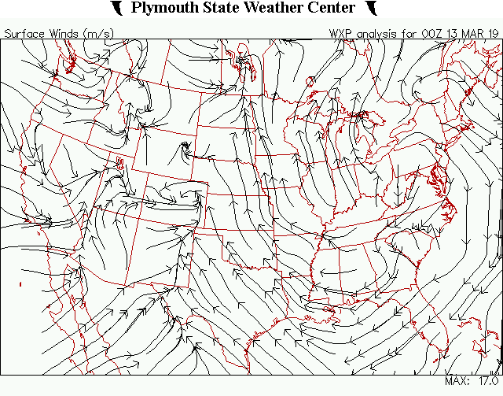
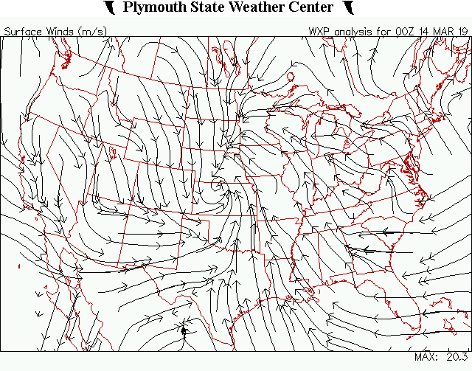
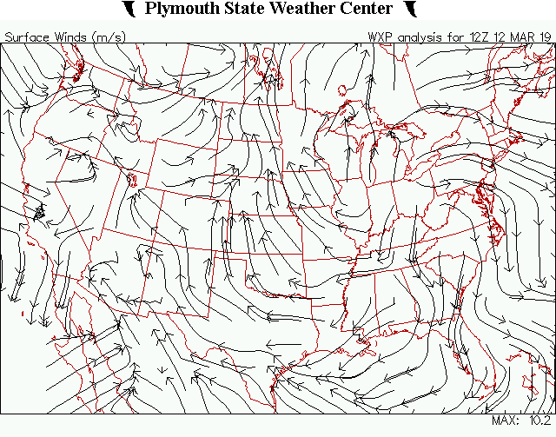
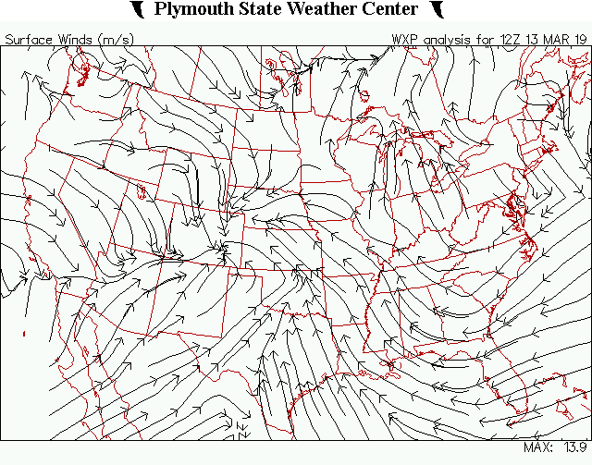
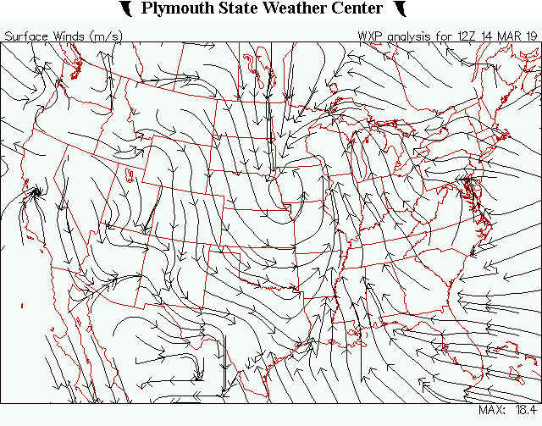
Notes:
Surface Winds Streams 3/12 00z – 3/14 12Z, These charts show the surface winds and show convergence at the surface. Where winds converge they have to go somewhere. The winds blowing in from a warm Maritime Tropical (mT) airmass enter the Mid Level cyclone (L) and rotate inward and upward. Weather does not exist in two dimensions but in three so the air that has converged, with its abundant moisture rises and disturbs the stable dry upper atmosphere. A process known as (W)RECHCR occurs. The acronym stand for the following: (W) arm air (R)ises, rising air ( E ) xpands, expanding air ( C ) ools, cool air (H)umidifies, humdified air supports ( C ) ondensation promotes (R) Rain. Depending on conditions during the descent the particles can be in the form of rain, snow, sleet, or hail.

Slide 13
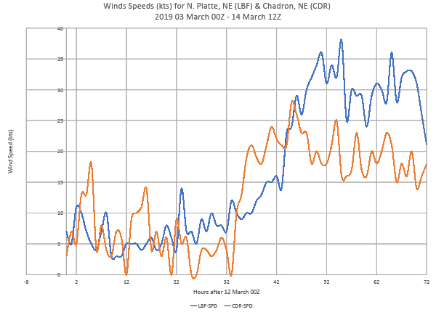
Notes:
Wind Speed chart for Chadron NE and N. Platte NE. I created this chart based upon data from Meteograms that obtained from the Wyoming Weather Web. I think it is easier to see a graphic representation as to the profound changes in the wind speed that occurred during the storm. The preceding charts showed the wind direction but this shows the sustained Wind speed numbers. The first 32 hours of the storm were up and down but a sustained increase was notes at 33hours into the storm. As N. Platte (LBF) was closer to the more intense portion of the storm the winds were higher and stayed higher.

Slide 14
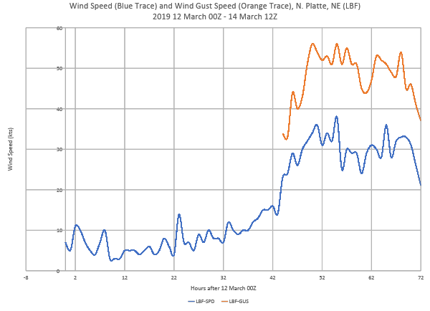
Notes:
Wind Gust Speeds N. Platte NE. I created this slide to show that, 48 Hrs into the storm, the winds were mostly at 25kts to 38kts. The Orange trace represents over a sustained period that ranged from about 35 kts to a high of about 56kts. This was over a period that spanned approximately 26 Hrs. According to Grace Miller from Accuweather.com, Blizzard conditions are said to have been obtained if storms contain a large amount of snow or blowing snow, winds in excess of 35 mph & visibility less than ¼ mile for at least 3 hours. Clearly this met or exceeded these criteria. Snow totals for the duration of the storm will be presented later in this analysis.

Slide 15
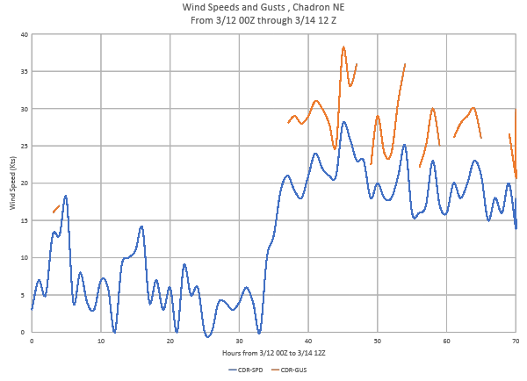
Notes:
Wind Speed and Gusts Chadron NE. I created this chart to show that, while it was likely that Chadron met the 3 Hour period of wind gust over 35 kts, it did not experience nearly the sustained effects of the winds as were experience in N. Platte. This is not meant to diminish the severity of what occurred, far from it, rather it is to show that the storm presented differing conditions and outcomes over a wide range of territory.

Slide 16
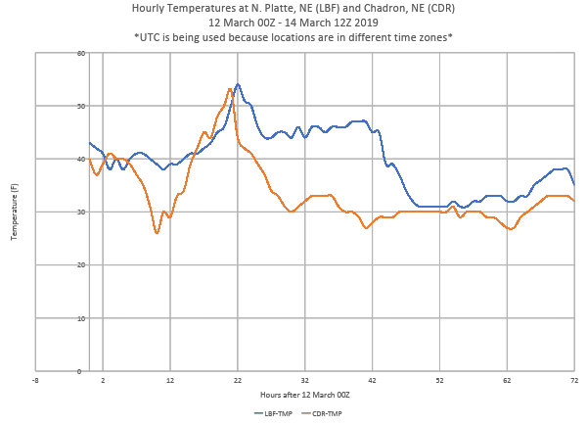
Notes:
Temperature Chart Chadron NE, N. Platte NE. For this to be a snow event and meet the standard of “Blizzard” conditions the temperature had to be conducive to snow as opposed to rain. The surface temps were not in the ballpark in the beginning of the observed period reaching temps in the mid 50’s. As the storm intensified the temperatures dropped to near freezing for a sustained period. The differences in altitude played a roll on this front. Chadron is at a higher altitude, and temperature drops with increases in altitude. Of importance to remember is that COLD Continental Polar (cP) air came down behind the warm air creating the clash of fronts and aiding in the creation of Blizzard conditions

Slide 17
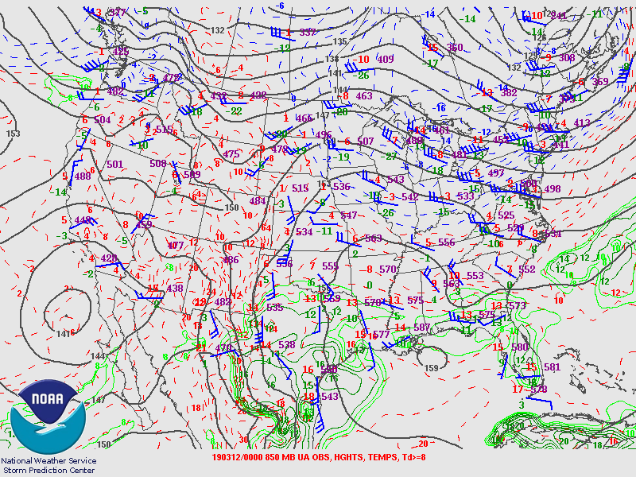
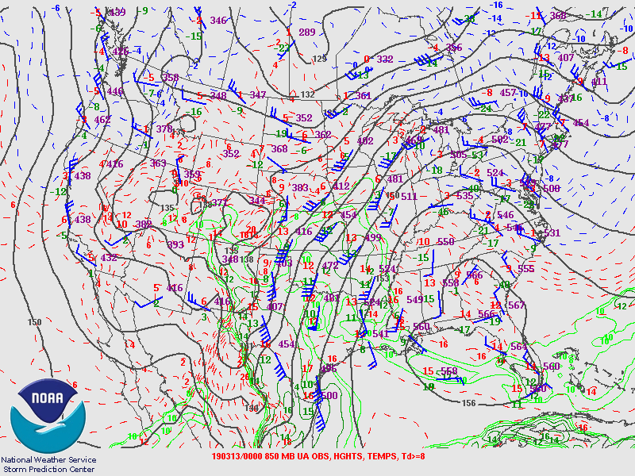
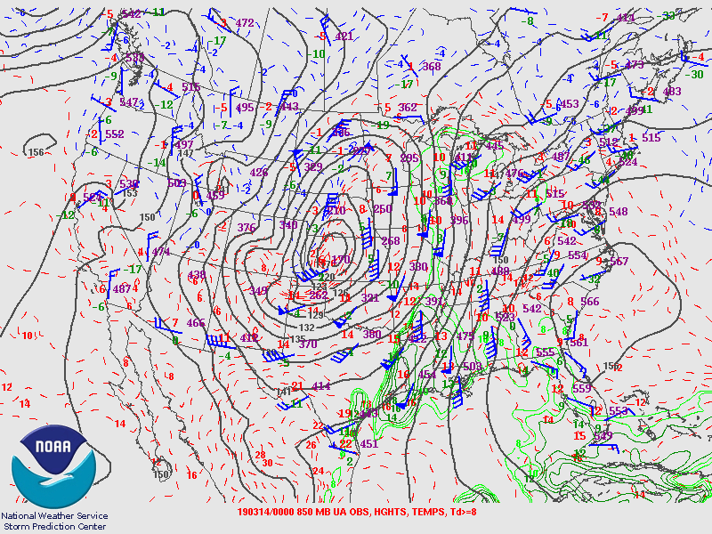
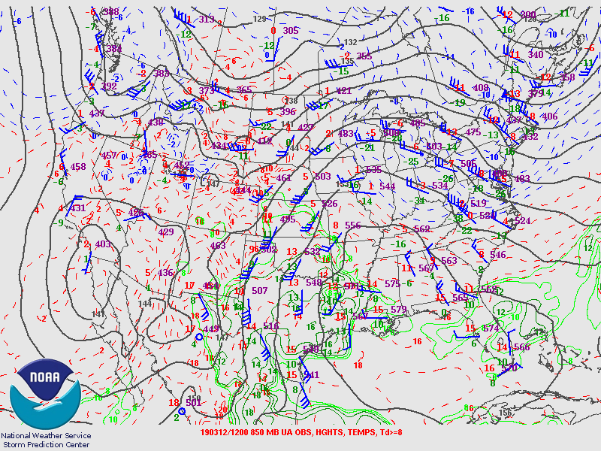
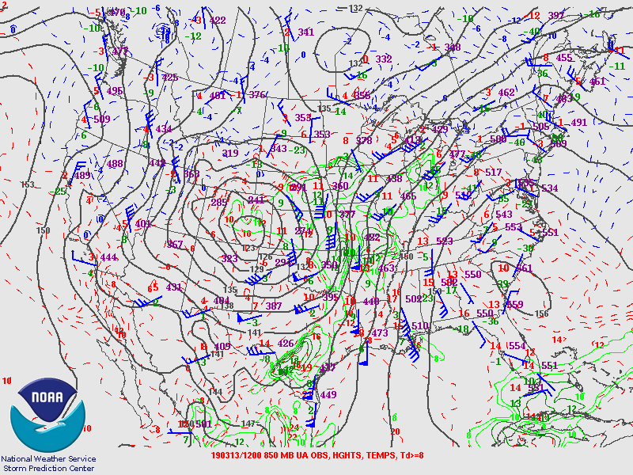
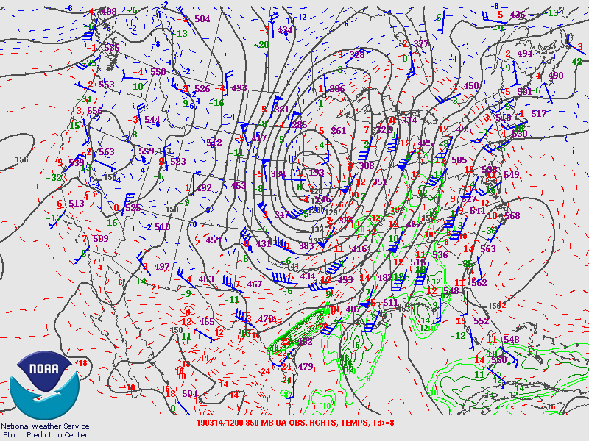
Notes:
850 MB Charts from 3/12 – 3/14. On the 850mb charts I am looking for higher wind speeds and the influx of water vapor from a Tropical Air Mass ( mT). The moisture from a water source is show on the maps as being a green lines. The wind speeds are shown by the Blue barb or feathers that show the direction that the wind is coming from. Triangles on the barb indicate wind speeds of 50 kts, long lines indicate 10kts, and half lines indicate 5 kts. On 3/13 it can be seen on both the 00Z and 12Z chart that wind speeds greater than 30kts are continually present as is moisture vapor from a mT air mass. On the chart of 03/13 at 00Z the winds are directly from the south with the low not being fully formed, that is NOT the case at 12Z. At 12Z on the 13th the low is clearly formed the windspeeds have increased and convergence, thus lift, is clearly evident as observed by winds entering to the south of the low, converging with the southern winds and wrapping into the upstream side of the trough. This is indicative of a low level jet. This condition continues into 3/14 with moisture from the south pumping into the storm.

Slide 18
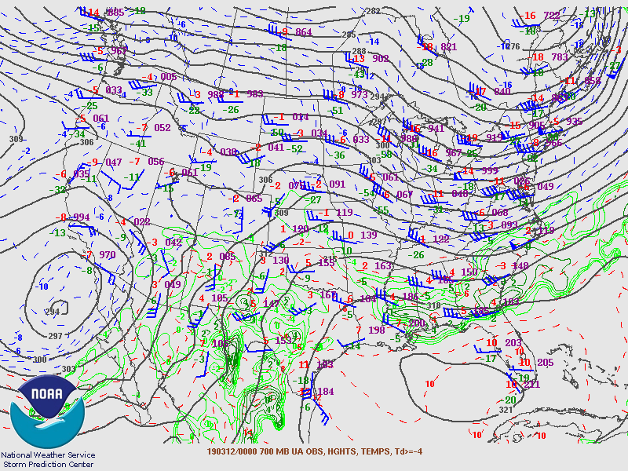
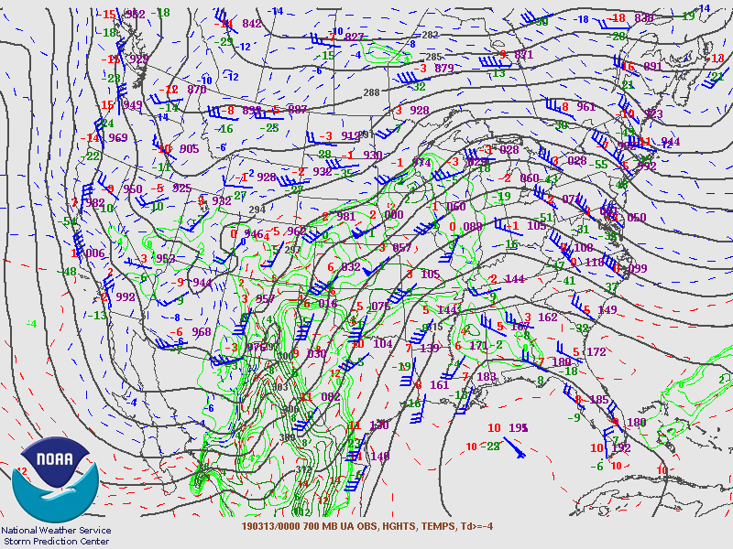
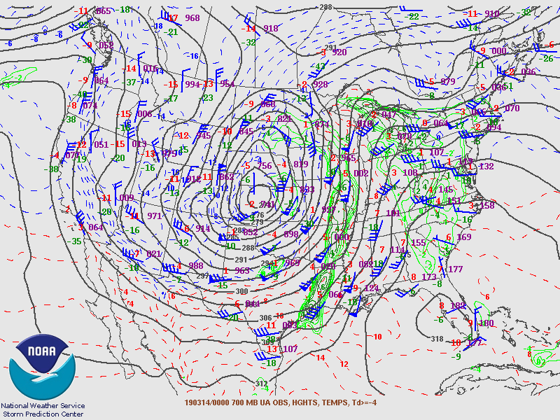
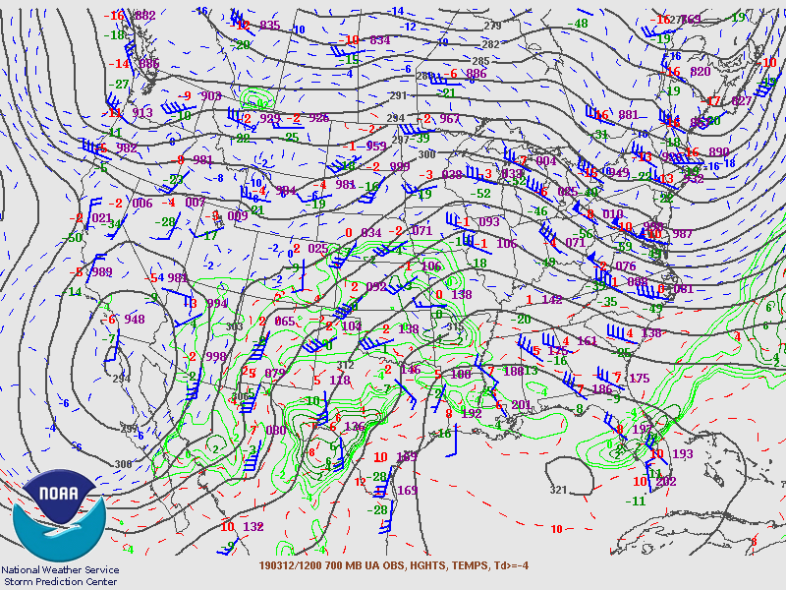
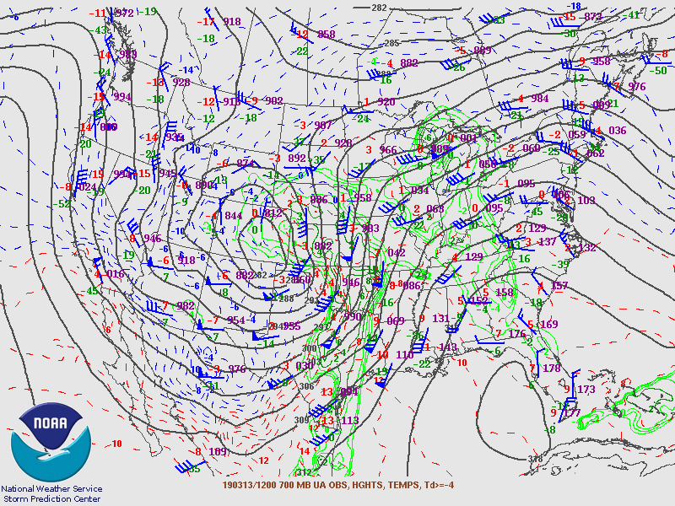
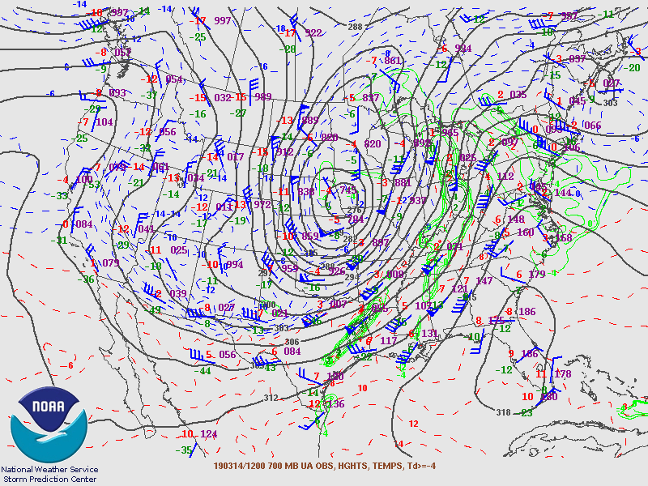
Notes:
700mb Charts from 3/12 -3/14. In this chart I am looking or a long wave trough (a large and pronounced dip in the isobar lines). The trough becomes clearly defined in the 3/13 12Z image. Also, less apparent but very significant is the presence of a short wave trough. This short wave trough can be seen as a bump or dip in the generally smooth isobar lines. But what do these two troughs mean and how do they affect the storm? Long range troughs are upper air disturbances or undulations if you will. Troughs are associated with low pressure systems (L) and a ridges with high pressure systems. As moist air spirals upward from the surface where it converges and it needs a place to go. It goes to an area of upper air divergence. Winds from below are said to develop downstream from an upper level, low pressure trough (Lutgens, p236). The Short wave tough, according to in class presentations does not create the active weather, rather, it tends to intensifies the storms that are beneath it (Krayer, 2019).

Slide 19
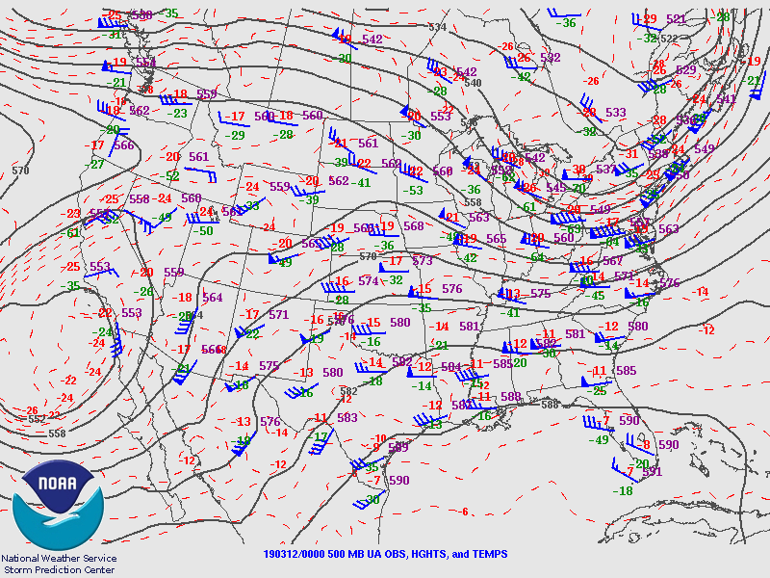
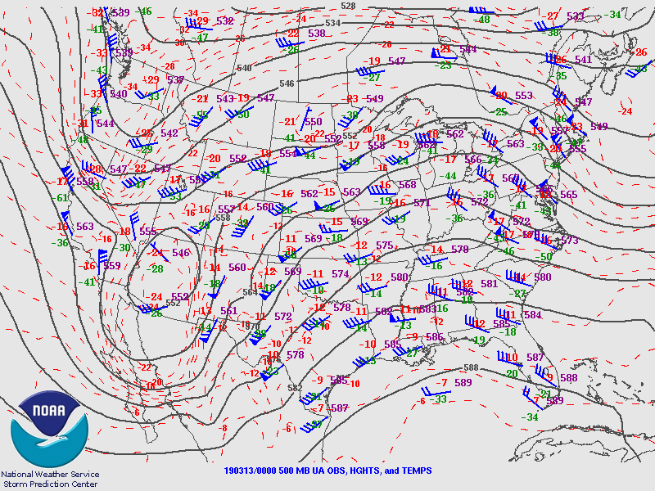
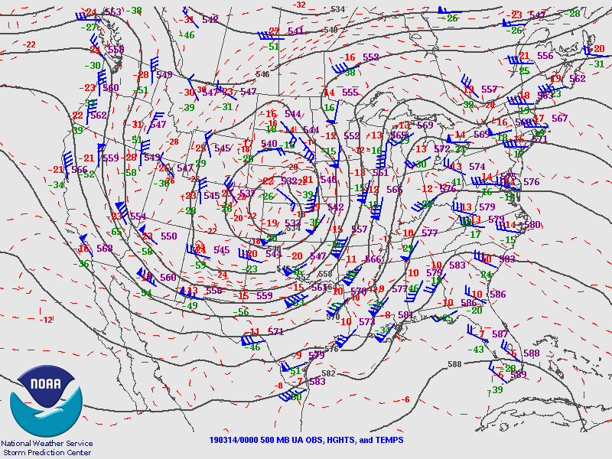
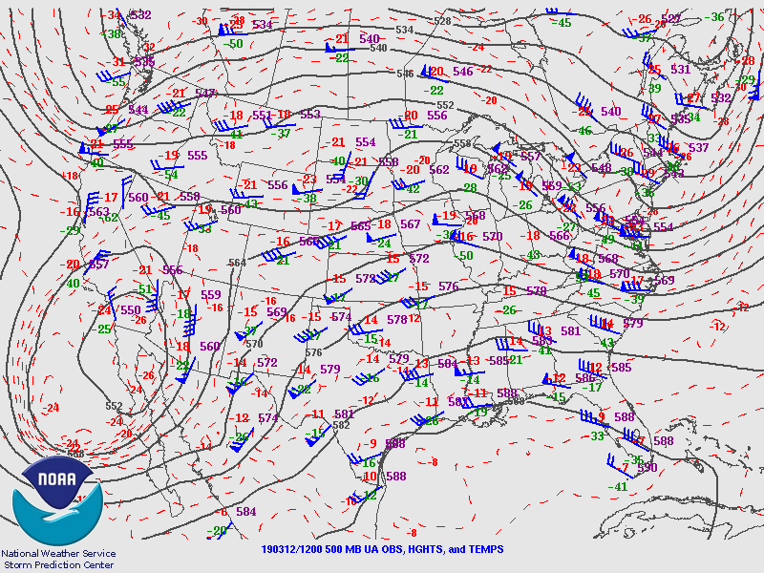
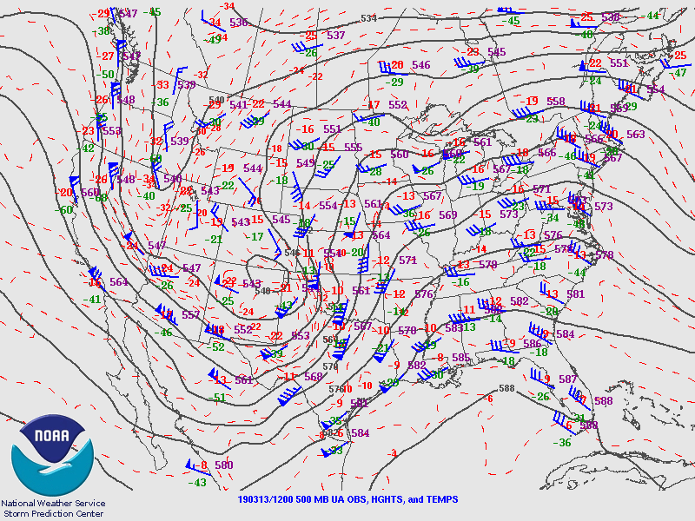
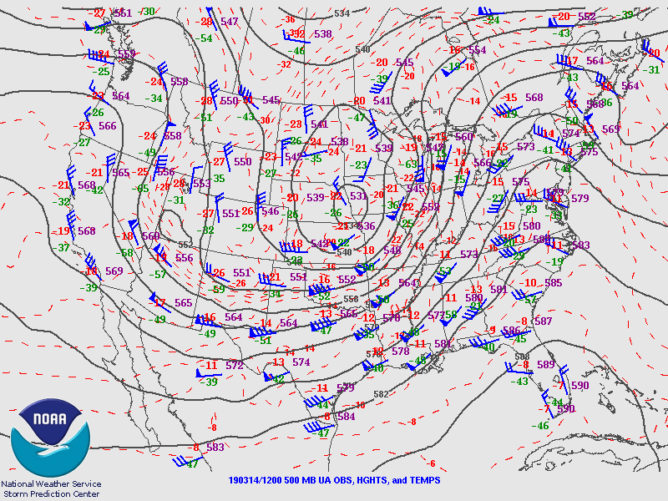
Notes:
500mb Charts from 3/12 -3/14. These charts show the ridges and troughs in the upper air wind. These higher level (altitude ) winds aid in steering the path of the storm. Convergence can be seen on the upstream portion of the trough and Divergence on the downstream side. This is relatively clear to see on the image of 3/13 and 3/14 at bot 00Z and 12Z. The wind speeds are clearly accelerating coming out of the trough as opposed to entering it.

Slide 20
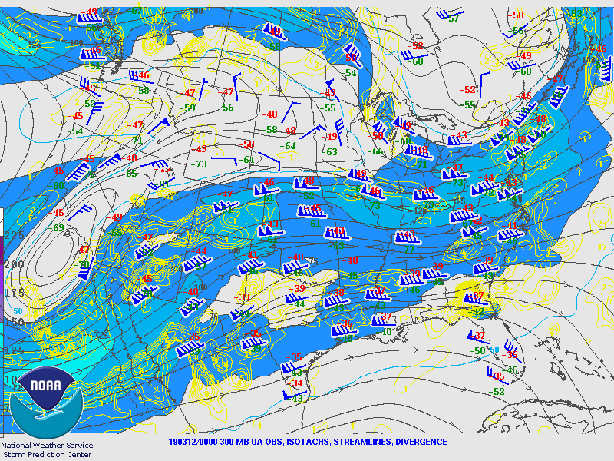





3
3
4
1
4
1
2
2
Notes:
300 MB Charts from 3/12 -3/14, These charts show what are referred to as Jet Streaks and areas of convergence and divergence. Remember that rising air = active weather
( Krayer, 2019) . If warm air cannot rise and form clouds and subsequent precipitation the atmosphere is considered stable, We have already determined that the warm air converged on the surface level, entered into cyclonic rotation (bringing it inward and upward) now the air has to get moved for storms to move or change in intensity.
Jet streaks are intense high speed flows of air at the highest levels of the Troposphere (The level of the atmosphere where human life exists). We learned in our course of instruction that Jet Streaks are higher speed channels of air that flow within the jet stream (Krayer, 2019). Within the Jet streak are 4 zones where 2 things occur and in different magnitudes. Strong and Weak Convergence, and Strong and Weak Divergence. Zone 1 and 4 are where winds Converge, with Zone 1 being the strongest. Zones 2 and 3 represent Divergence Zones with zone 2 being the Stronger. The divergence aloft promotes the entrance of the warm moist air and further destabilizes the atmosphere and can strengthen the storm.

Slide 21






3/12 00Z
3/13 00Z
3/14 00Z
3/12 12Z
3/13 12Z
3/14 12Z
Notes:
These Weather Front images cover 3/12-3/14. I chose to end with these maps for several reasons. The other maps show a tremendous amount of data and can provide different pieces of information that are used to explain and or predict what weather is going to occur, where and when. For those of us studying weather the charts and data are pivotal for forecasting. For most of the public, and some students, maps such as these represent an easy depiction of what is expected to occur. A look at these maps during the period of 3/12 – 3/14 confirms what analysis of the individual maps, charts and data showed. This visual format is easier on the eye and confirms the prediction of snowfall that existed in during the Blizzard portion of Winter Storm Ulmer.

Slide 22
Conclusion
There were several key factors that lead Winter Storm Ulmer producing blizzard conditions in Nebraska (NE) and many parts of the Midwest. The first was the formation of the Colorado Low that ultimately developed into Ulmer and developed conditions that evolved into Bombogenisis status. The low front and its lifting cyclonic circulation was fed warm moist air stemming from a Maritime Tropical Air Mass. This warm tropical air mass clashed with a Continental Polar (cP) air mass and the set up was right for a significant weather event. The low front was south of Nebraska, in Kansas, and was slowed from moving east by several stationary fronts to the north. The storm continued to grow in intensity and became occluded. The cold air was being pumped in from the north with the approaching high pressure system and the low pressure system was still being fed moisture. The winds from the cold front and associated high winds created the Blizzard conditions that were experienced in many parts of Nebraska. The weather prediction center in College Park, MD confirms that 17.2” of snow fell during the Blizzard in Chadron NE.
This storm had many more far reaching implications for the Nebraska such as the duration and magnitude of flooding which caused catastrophic damage throughout the state. This was a storm worthy of analysis and gave this student an opportunity to put together all the concepts we have learned in class. Meteorology and weather forecasting is complicated but is crucial to providing accurate and timely information that can save the lives of people living in a storms path.

Slide 23
References Page
Dolce, C. Images that Show How the Latest ‘Bomb Cyclone’, Winter Storm Ulmer, Came to Be, image retrieved from https://weather.com/safety/news/3019-03-13-winter-storm-ulmer-bombgenesis-satellite-images-bomb-cyclone
Hanson, K., Late winter storm blasts the Great Plains, images retrieved from https://earthobservatory.nasa.gov/images/144673/late-winter-storm-blasts-the-great-plains/
Lutgens, F., Tarbuck, E., & Herman, R. (2019) The Atmosphere: An introduction to meteorology 14th Edition. Pearson Company
Miller, G., (2-5-13), What is a Blizzard, as retrieved from https://www.accuweather.com/en/weather-news/what-is-a-blizzard/5674708
National Weather Service Geostationary Satellite Server, as retrieved from http://www.goes.noaa.gov/
Plymouth State University Weather Center, as retrieved from http://vortex.Plymouth.edu/
United States Map with Topography, as retrieved from https://worldatlas.com/webimage/countrys/namerica/usstates/bwnames.htm
University Corporation for Atmospheric Research, Image Archive, as retrieved from http://www2.mmmucar.edu/imagearchive/
W. Krayer, personal communication, March/April, 2019

